Slide 1
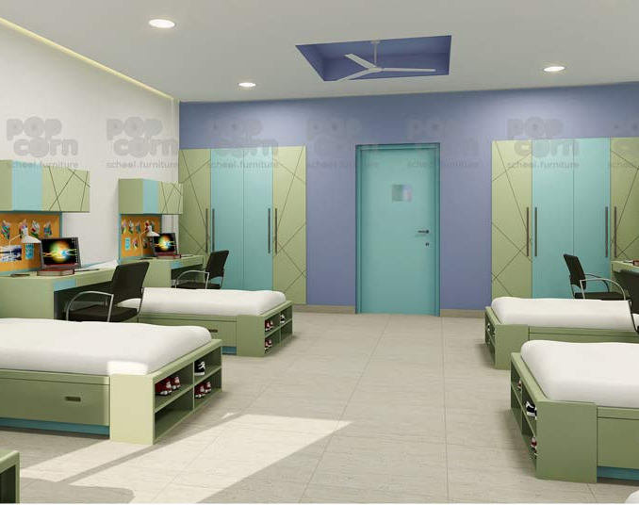
HOSTEL FIXER
INNOVATIVE SOLUTIONS FOR COMMON HOSTEL CHALLENGES

Slide 2
OBJECTIVES
Identify Common Complaints : Determine the most prevalent complaints and issues that students face in hostels, such as cleanliness, maintenance, noise, safety, or roommate conflicts.
Develop Solutions: Create practical and actionable solutions to address each identified complaint or issue.
Implement Feedback Mechanisms: Establish a feedback system to monitor the effectiveness of solutions and gather ongoing input from residents.
Continuous Improvement: Continuously review and update strategies based on feedback and changing needs.

